Slide 1
Video Games Sales
Nabil & Philippe – 2023 oct

Slide 2
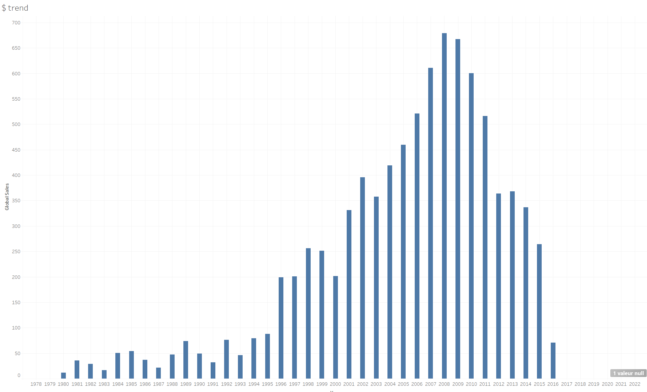
Market revenue & trend

Slide 3
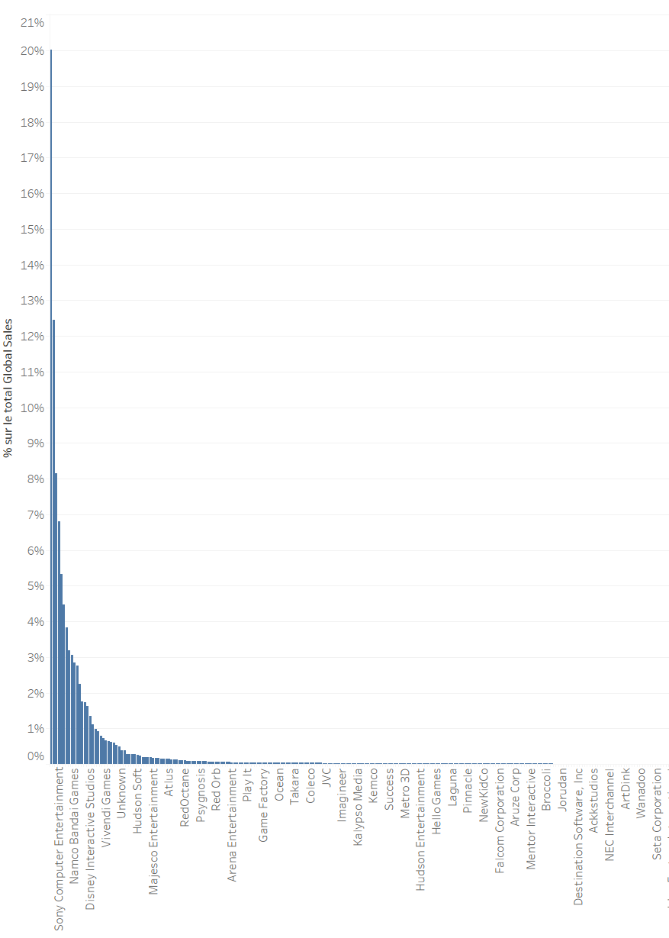
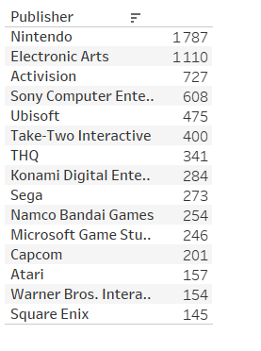
The long tail issue
A very fragmented marked
579 publishers listed
15 publishers = 80% of revenue

Slide 4
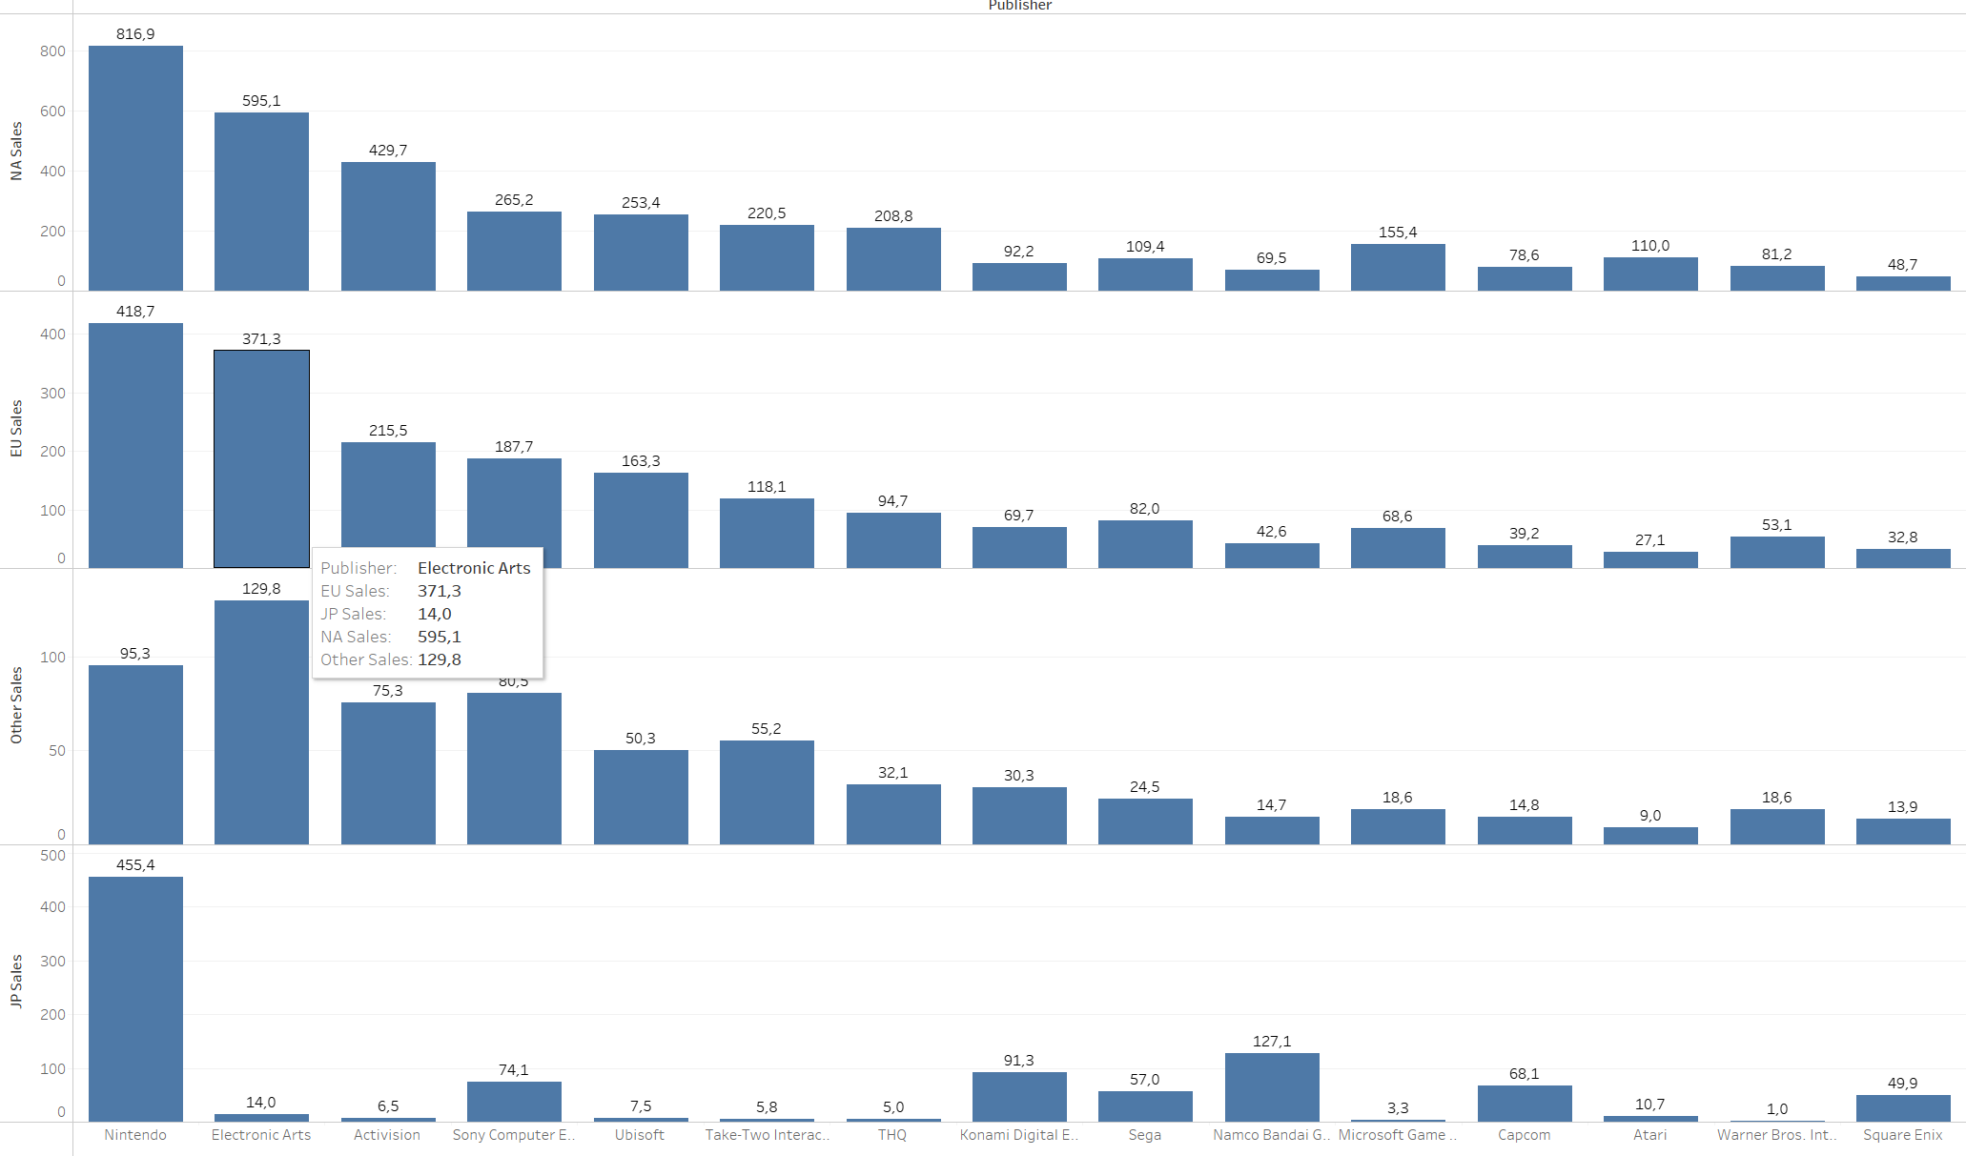
Top 15 publishers among areas
% of market shares in US and Europe are similars
JPN shows a specific profile

Slide 5
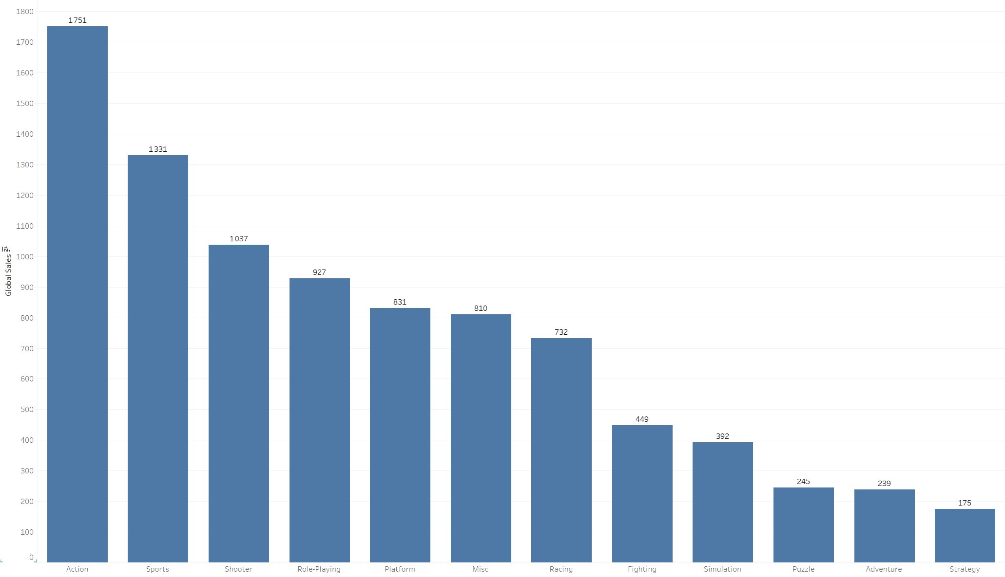
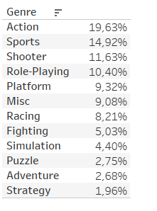
80% of the market with 5 differents Genre

Slide 6
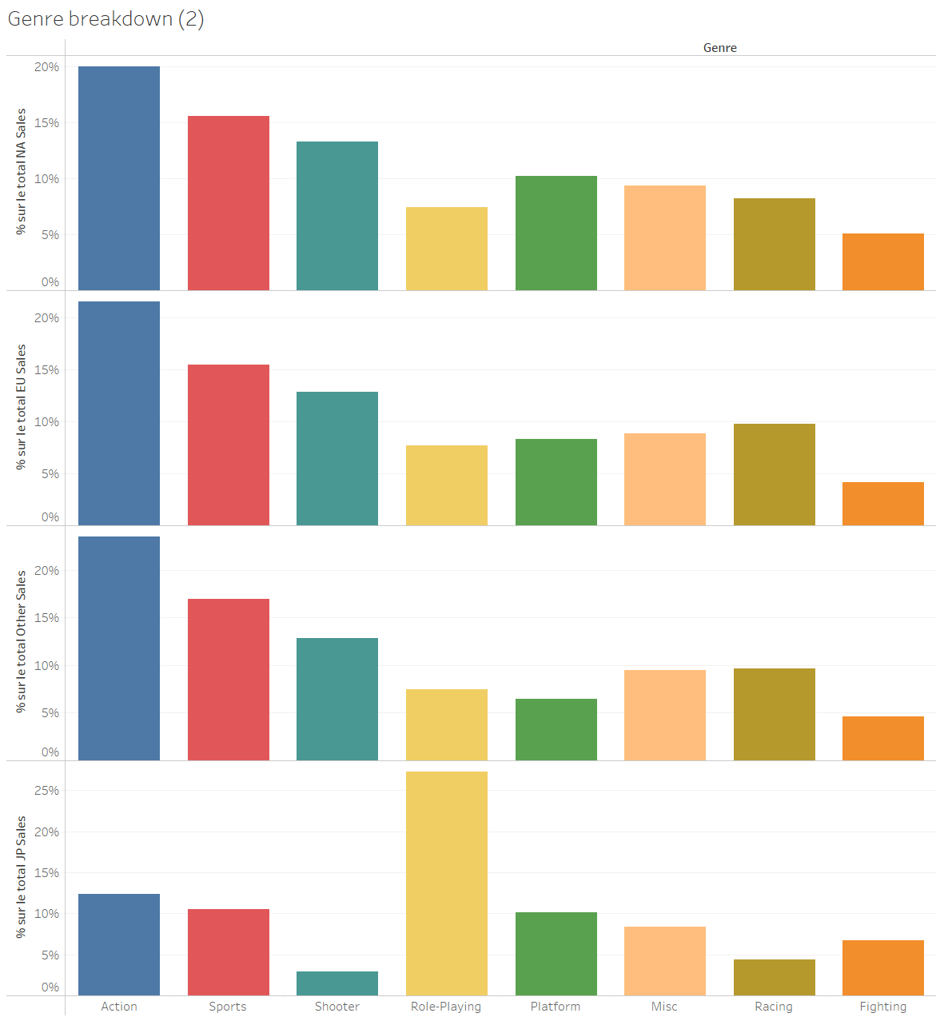
Genre market share by region
% of market shares in US, EU and others are similars
JPN shows a specific profile

Slide 7
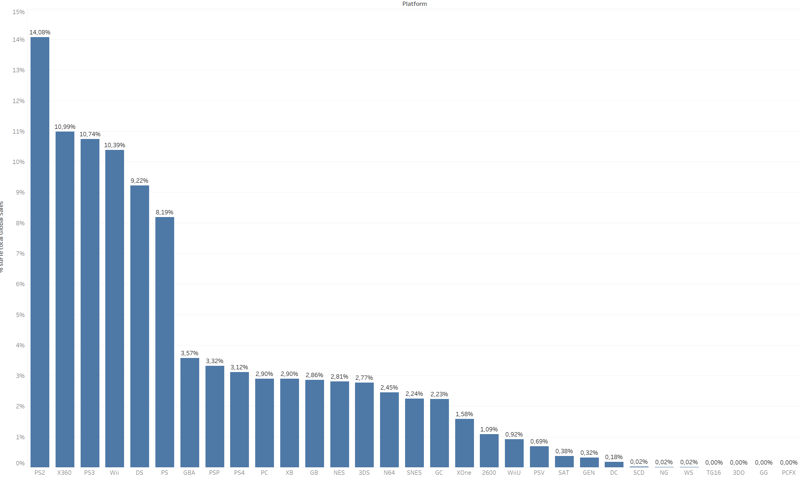
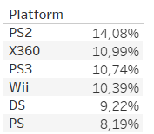
2/3 of the market with 6 platforms

Slide 8
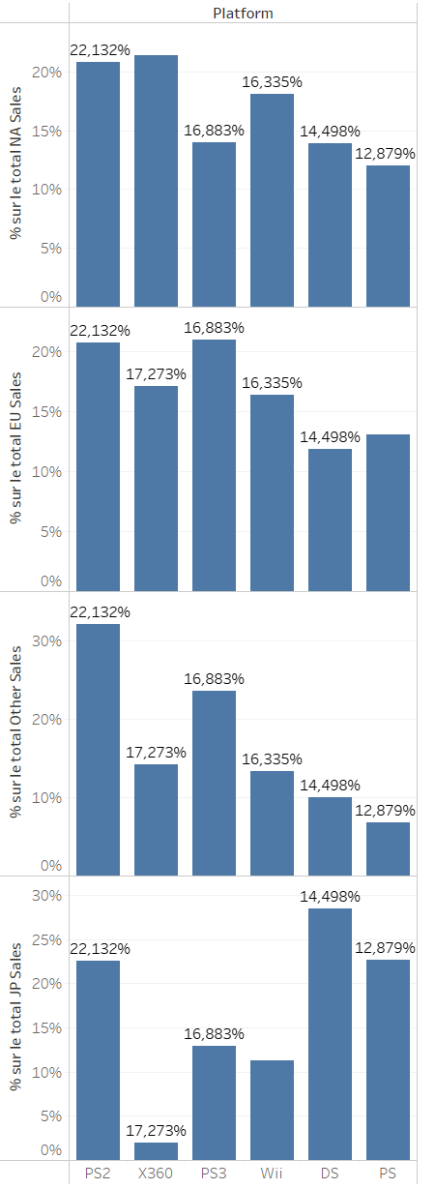
Top platforms among areas
Top platforms are global players
Except the X360 which is NOT used in JPN

Slide 9
Summary so far
Too few big players
Too many platforms
Actions sport & shooter
Japan is very specific (platform, genres, one market leader)

Slide 10
Preliminary feedback about Tableau
We are discovering the product
Tableau public seems very limited
Hard to draw pareto charts with cumulative plots (easy in Excel)
https://kb.tableau.com/articles/howto/creating-a-running-sum-of-each-color-values-across-a-stacked-bar-chart?lang=fr-fr
Hard to have in the same array values and % of total (easy in Excel)
Once a list is filtered to focus on the top 10, % are recalculated among those 10 items. This is usually NOT what we want
Stories are very limited and should be avoided (pptx should be prefered)

